Slide 1


Executive Sales Performance Report
A Power BI Dashboard Analysis of Revenue, Profitability, and Customer Trends

Slide 2
Project Overview & Objectives
Transforming raw transactional sales data into intuitive visual business intelligence assets for stakeholder optimization.

Slide 3






Key Strategic Objectives
Performance Monitoring
Product Taxonomy
Customer Demographics
Track high-level KPIs including Total Sales ($2.30M), Net Profit ($291K), and dynamic profit margins across regions and calendar periods.
Analyze merchandise metrics across Furniture, Office Supplies, and Technology to identify top-performing revenue drivers and margin leaks.
Segment purchasing behaviors across Consumer, Corporate, and Home Office client tiers to isolate high-value lifetime accounts.

Slide 4


Data Methodology & ETL Pipeline
Data Ingestion & Cleaning
Modeling & Calculations
•
Sourcing: Raw sales orders, metadata, regional metrics, and client profiles ingested into Power BI.
•
Relational Modeling: Linked tables natively to support cross-filtering across visuals.
•
ETL Formatting: Standardized data types, harmonized order/ship dates, and cleansed null product descriptions using Power Query.
•
Custom DAX Measures: Developed formulas for Total Sales, Net Profit, Average Order Value, and cumulative running totals.
•
Deduplication: Removed duplicate order IDs to ensure structural integrity across transactional tables.
•
Feature Engineering: Created calculated columns for Sales Tax (10%), Custom Discount status, and revenue Tiers.

Slide 5

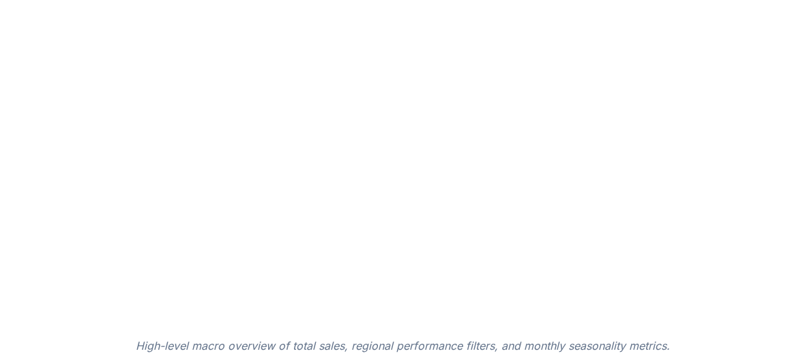
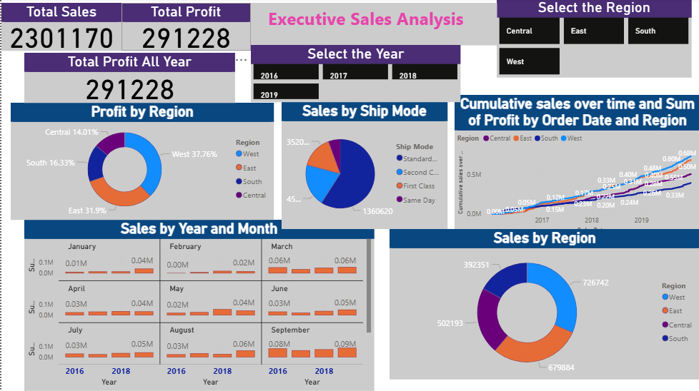
Dashboard View: Executive Sales Analysis

Slide 6
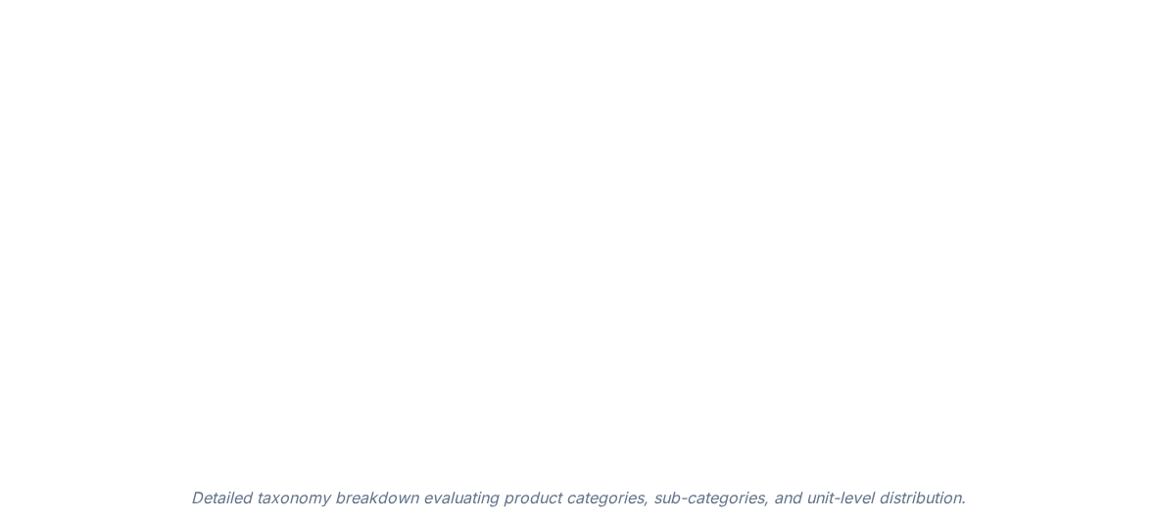

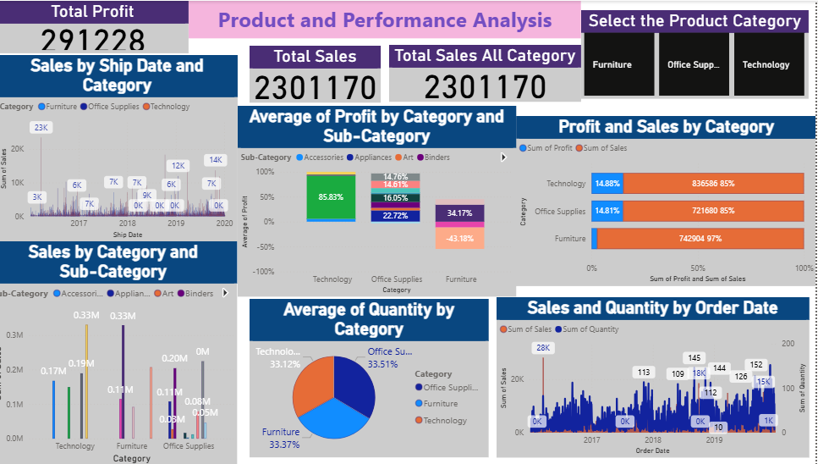
Dashboard View: Product & Performance Analysis

Slide 7
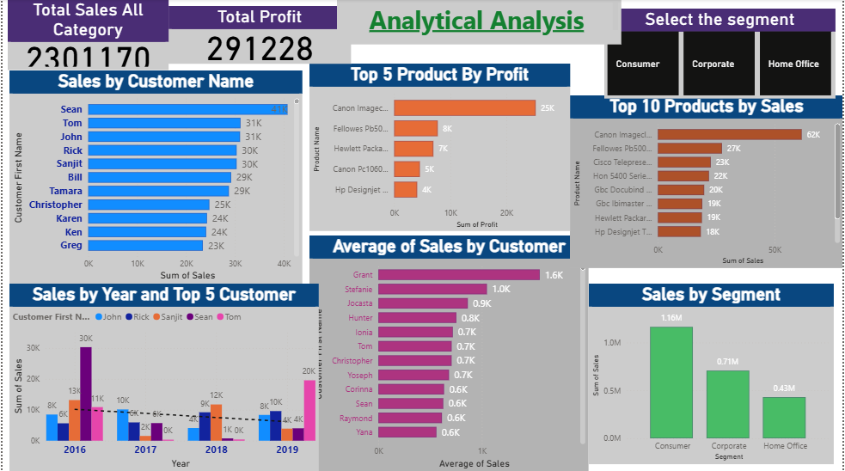
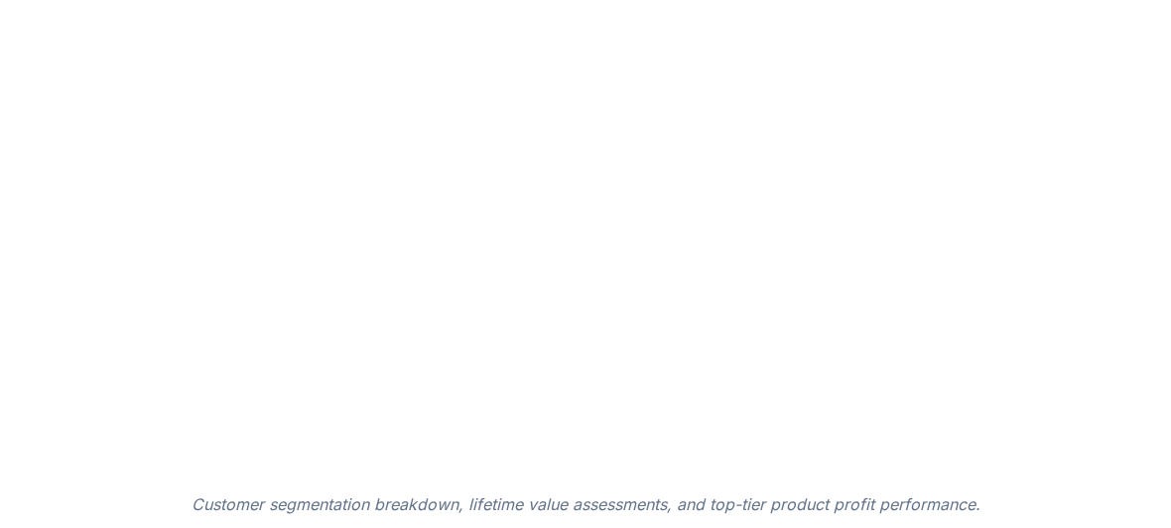
Dashboard View: Analytical Analysis

Slide 8
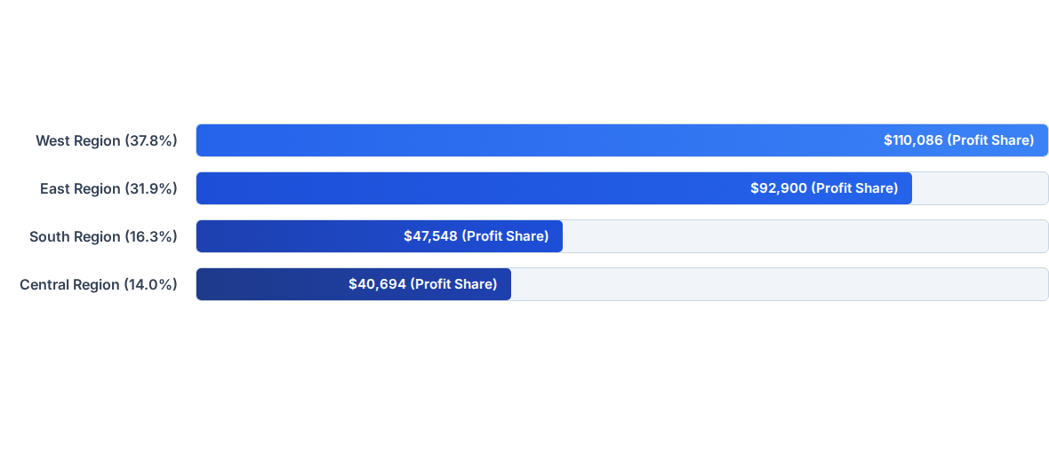
Regional Profit Distribution
The West and East regions combined account for nearly 70% of total company profits ($291,228 aggregate net profit against $2.30M sales).

Slide 9


Product Category Profitability Dilemma
Technology (High Yield)
Furniture (Margin Erosion)
Technology anchor items secure exceptionally healthy profit-to-sales ratios (~15% margin efficiency), led by top performers like the Canon ImageCLASS copier.
While Furniture constitutes massive sales volume (nearly 97% of its bar weight), its net profit contribution is paper-thin (3%) due to heavy discounting and freight expenses.

Slide 10
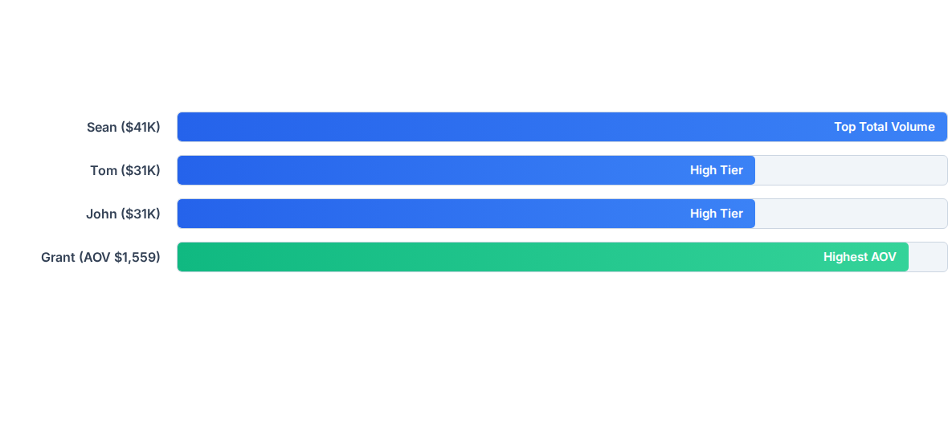
Top Customer Accounts by Revenue
Consumer segment acts as the foundational revenue backbone at $1.16M, while Corporate ($0.71M) and Home Office ($0.43M) maintain stable streams.

Slide 11
Strategic Business Recommendations
Mitigate Client Concentration Risk: Launch targeted acquisition campaigns to diversify customer portfolios and reduce reliance on single-account surges.
Optimize Furniture Category Margins: Investigate root cost drivers, shipping overhead, and discount frequencies eroding profitability in the furniture line.
Stabilize Seasonal Volatility: Structure recurring revenue offerings and off-season promotions to smooth out volatile "boom-and-bust" monthly profit cycles.

Slide 12
Questions?
Thank you for exploring the sales performance analysis presentation.
Anjali Sinha | CX-138-MOR-JUNE | Power BI BI Analytics

